Slide 1
ClassConnect
Team Members :
1. Anupam Zope - 230341220227
2. Rahul Badhe - 230341220041
Guided by:-
Ms. Manjiri Deshpande

Slide 2
Introduction
ClassConnect is an online platform to assist students to find a private tutor in both remote and physical mode or to find a online interactive class according to comfort and budget. It also helps individual who are looking to offer tutoring services.
ClassConnect will allow students to outlook and subscribe to various courses. Tutors will be able to offer several courses according to their proficiency. Admin will be able to manage students and tutors and to approve registration of new tutors. The System will generate live Business Operations statistics trends through customized dashboard for stakeholders.

Slide 3
Technology Used
We used Java Spring-Boot as backend and React JS as Frontend in our Project.
Spring-Boot :–
The main goal of the Spring Boot framework is to reduce overall development time and increase efficiency. React has become the first choice for frontend because it gives developers the ability to work with a virtual browser (more friendly than the real browser). Also, a JavaScript developer can become a productive developer in a few hours because there is a small API to learn, a few functions, and how to use them…
React :–
React allows developers to create large web applications that can change data, without reloading the page. The main purpose of React is to be fast, scalable, and simple. Spring

Slide 4
Problem Statement
This project is aimed at developing a software application for the student and teacher, is a web based application that can be accessed throughout the globe.
The system is an online application that can be accessed by the students/parents and teachers as well, with proper login provided, which will give better service to the users.

Slide 5
Scope for Future Enhancement :
As the technology emerges, it is possible to upgrade the system and can be adaptable to desired environment.
Because it is based on object-oriented design, any further changes can be easily adaptable.
Based on the future security issues, security can be improved using emerging technologies.
Sub admin module can be added

Slide 6
Existing System :
In the existing system, the process of finding suitable tutors is often fragmented and time-consuming. Students rely on word-of-mouth, advertisements, or limited institutional resources to connect with tutors. This lack of centralized information and streamlined access leads to inefficiencies and mismatched tutoring experiences..

Slide 7
Proposed System :
The proposed system, our ClassConnect Application, revolutionizes the tutoring landscape. It introduces a comprehensive, web-based platform that seamlessly connects students with qualified tutors. Through advanced search algorithms and personalized profiles, the application simplifies the tutor discovery process. This system offers a user-friendly interface accessible globally, ensuring efficient and tailored tutor selection for optimal learning outcomes.

Slide 8
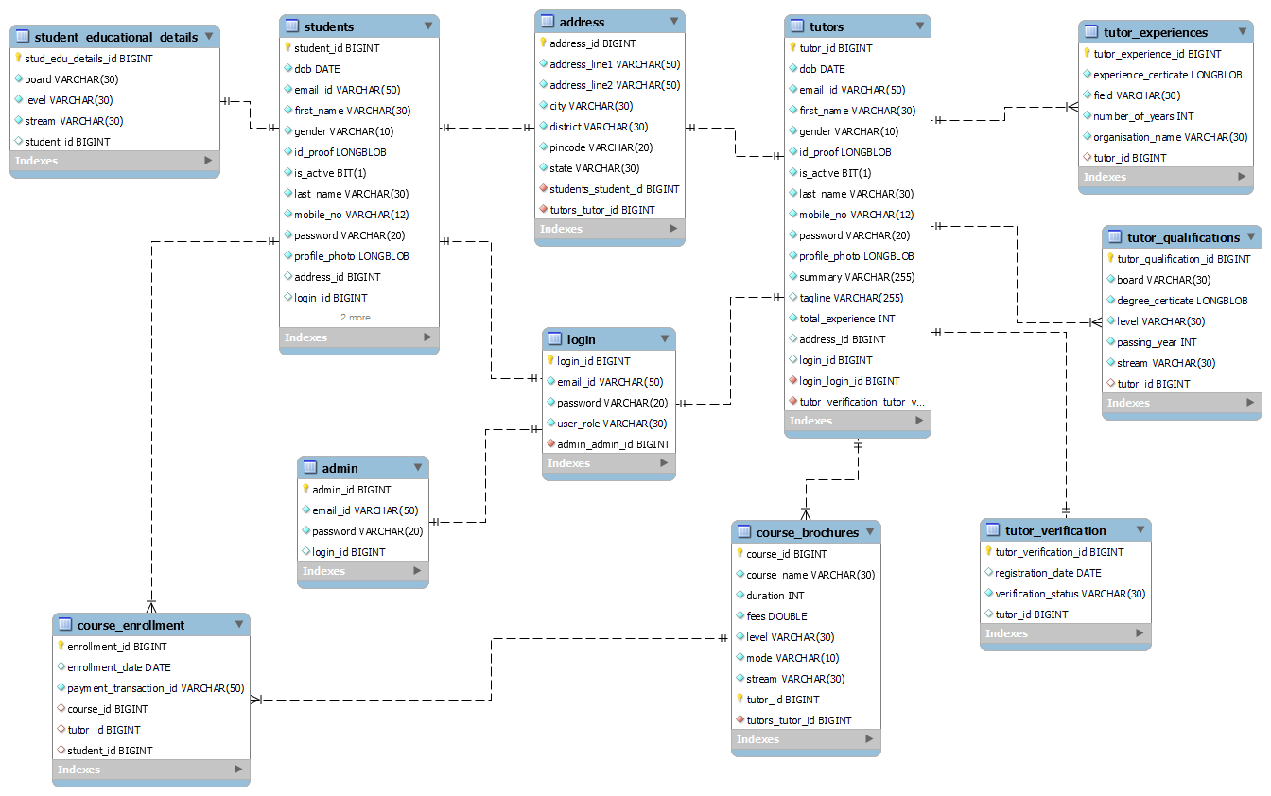
ER Diagram :

Slide 9
Modules :
The System is proposed to have the following modules:
1. Admin:
Administrative Rights, Event update.
2. tutor:
Restricted access, See events.
3. Student:
Restricted access, See Events.

Slide 10
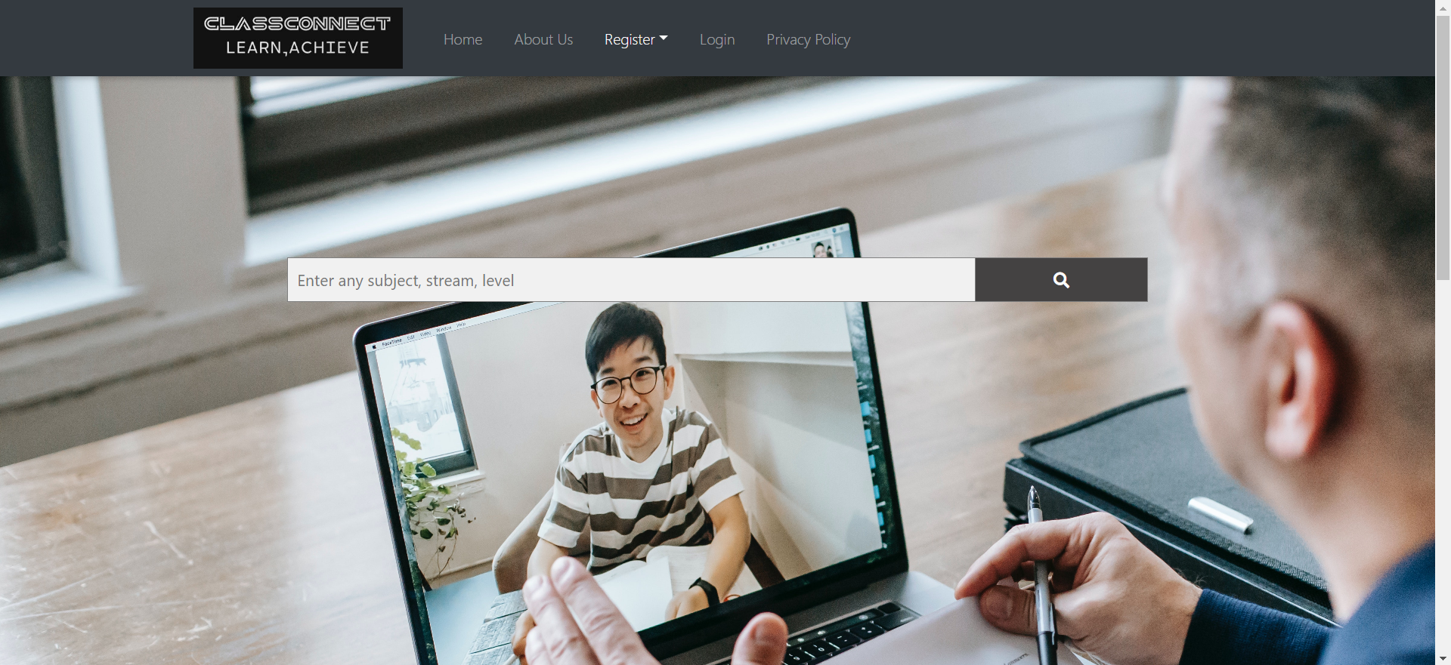
Welcome Page :

Slide 11
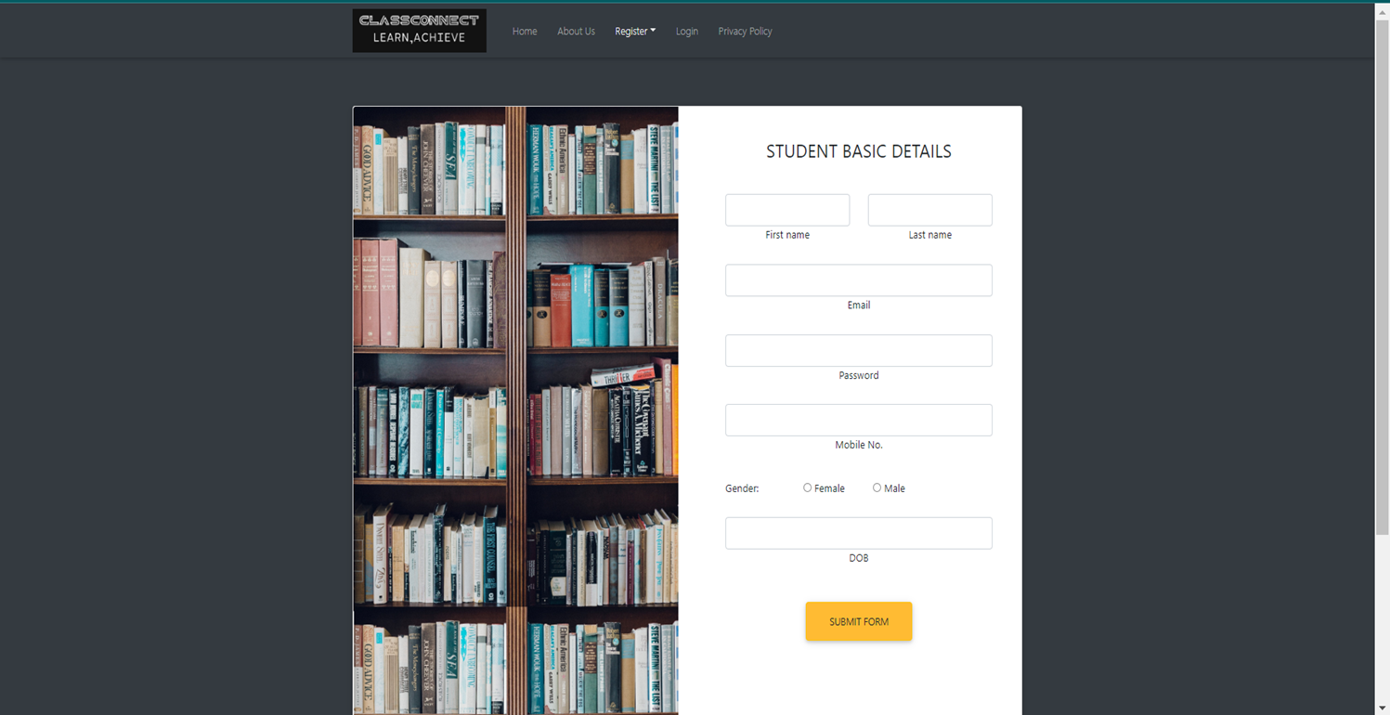
Student-Registration Page

Slide 12
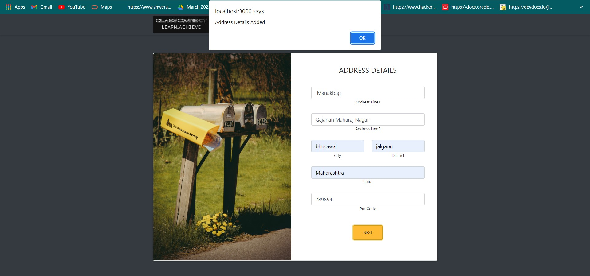
Student-address details :

Slide 13
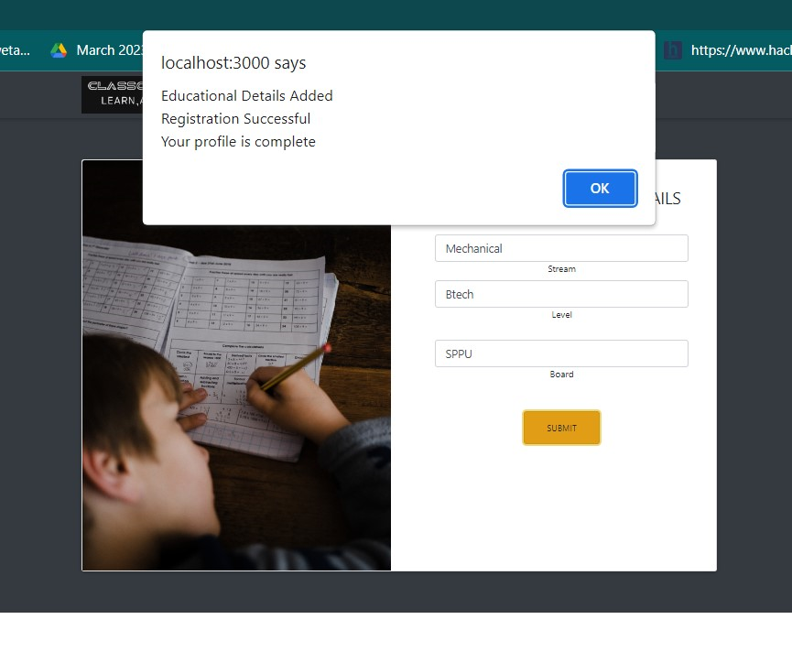
Student-Qualification Details :

Slide 14
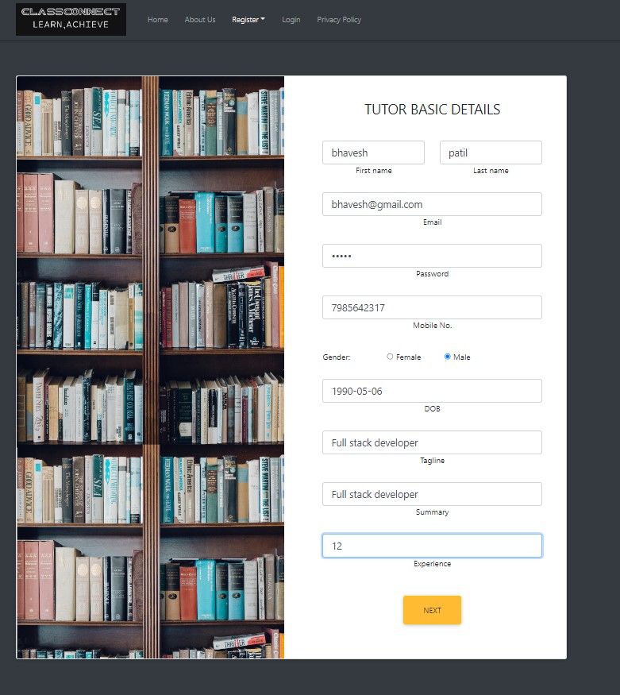
Tutor-Registration Page:

Slide 15
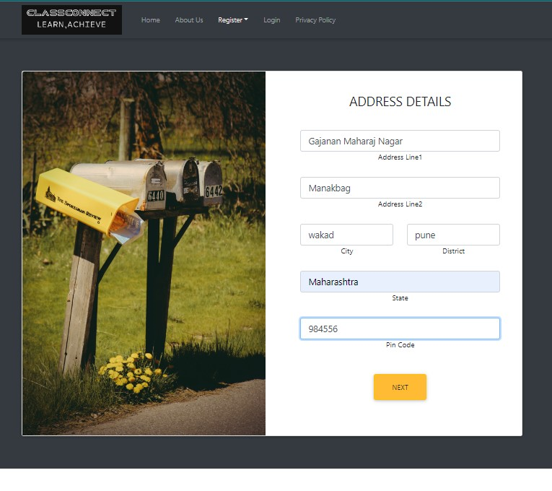
Tutor-Address Details:

Slide 16
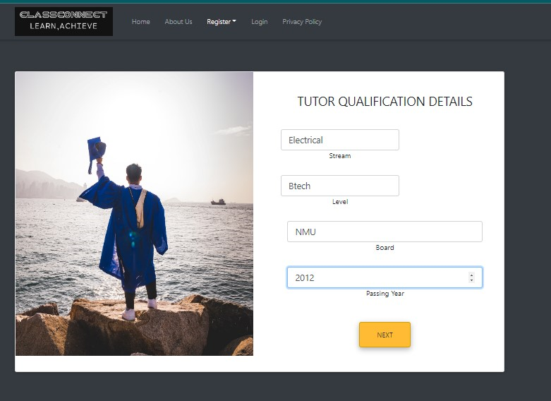
Tutor Qualification Details

Slide 17
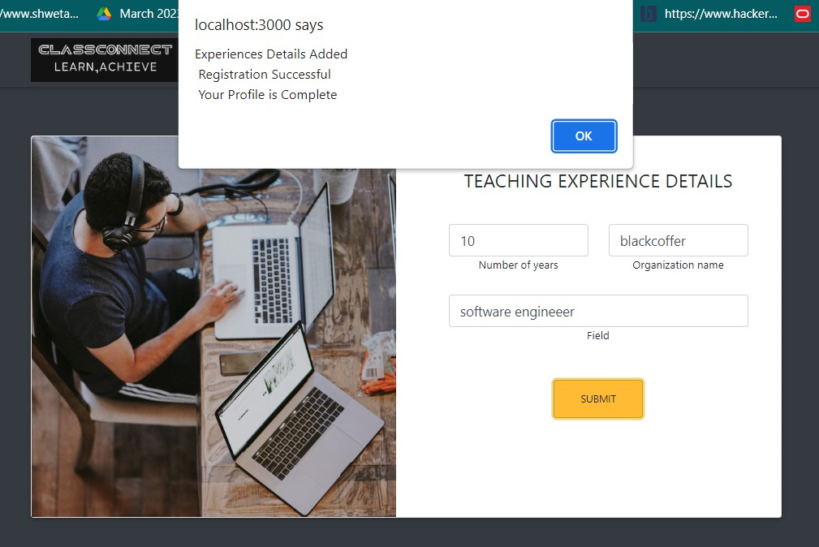
Tutor-Experience Details:

Slide 18
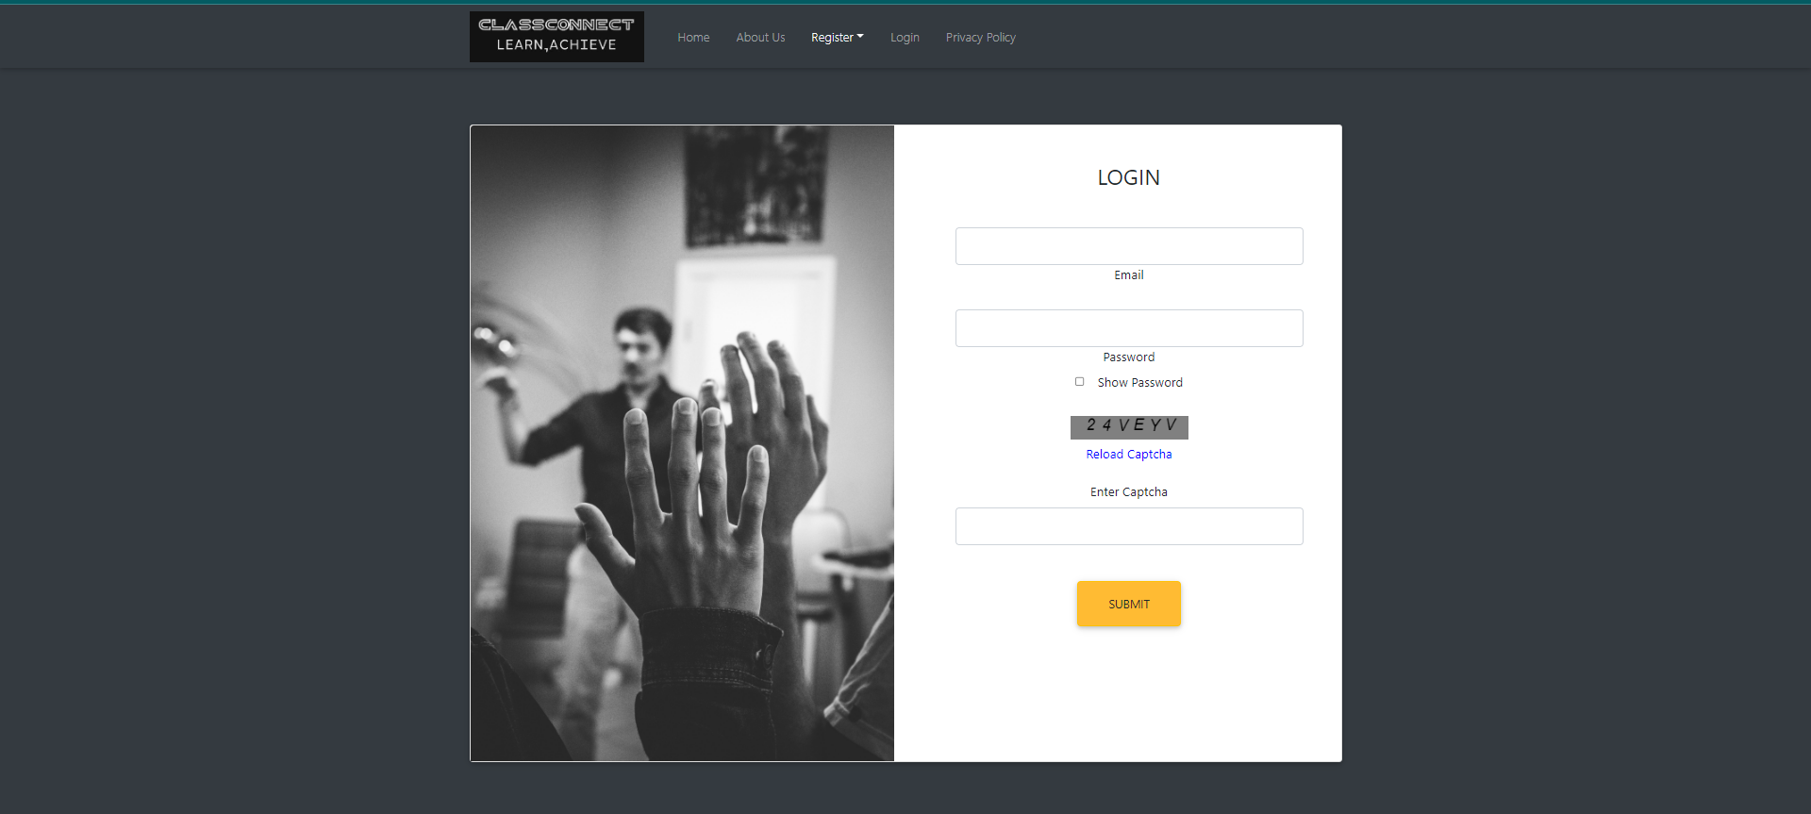
Student-Login Page :

Slide 19
Conclusion :
In conclusion, our ClassConnect Application addresses the modern need for a convenient and effective way to connect students and tutors.
2. By leveraging technology, we've created a user-friendly platform that streamlines the process, making tutor selection personalized and efficient.
3. This application is not just a tool, but a transformative approach to education, enhancing the learning journey for students and opening up new opportunities for tutors.
4. Embracing innovation, we're proud to present a solution that bridges the gap and fosters knowledge exchange in a seamless and impactful manner.
5. The system will generate live Business Operations Statistics trends through customized dashboard for stakeholders

Slide 20
References :
https://www.javatpoint.com/java-tutorial
https://www.geeksforgeeks.org
https://www.tutorialspoint.com/index.html

